Slide 1

The National University of Computer and Emerging Sciences
Logistic Regression
Data Science
Muhammad Zulqarnain
Department of Computer Science

Slide 2
Today’s Lecture

Slide 3
Logistic Regression
Linear regression models the relationship between a response variable and one or more explanatory variables.
For categorical response variable with two possible values, Similar Regression Models can also be used
Spam or Not Spam
Patient Dies or Survives
Tumor Benign or Malignant.

Slide 4
Logistic Regression
Classification, like regression, is a predictive task
But one in which the outcome takes only values across discrete categories;
Classification problems are very common (more common than regression problems!)
The objective function should be modified
Fundamentals will be same as regression

Slide 5
Logistic Regression
Logistic Regression (also called Logit Regression) is commonly used to estimate the probability for each class
What is the probability that this email is spam?
Can a binary classifier be constructed using probability?
If the estimated probability > 50%, the instance belongs positive class
Otherwise, it belongs to the negative class

Slide 6
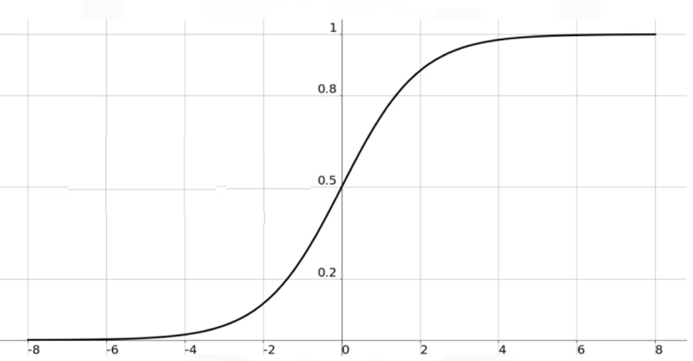

Logistic Regression
Suppose p(y=1|x) = p(x)
Sigmoid Function:
p$(x)= \frac{1}{1+e^{−W^{T}X}}$

Slide 7
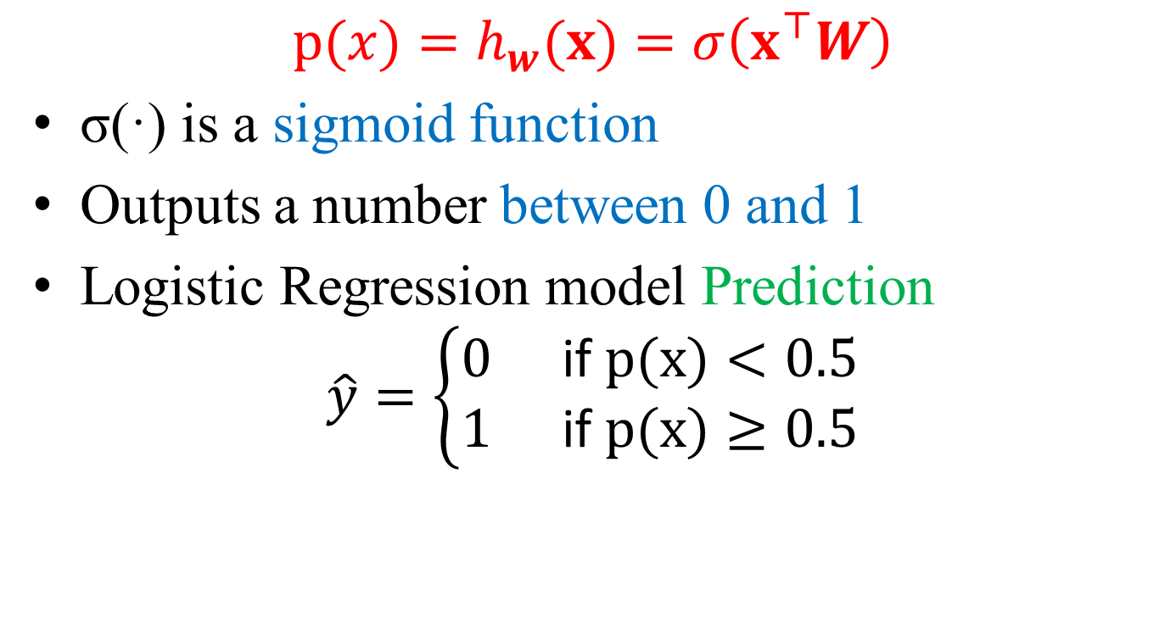
Logistic Regression
$$p(x)=h_{w}(x)=σ\left(x^{⊤}W\right)$$
σ(·) is a sigmoid function
Outputs a number between 0 and 1
Logistic Regression model Prediction
$$\hat{y}=\left\{\begin{aligned}&0 && \text{if} p(x)<0.5 \\ &1 && \text{if} p(x)≥0.5\end{aligned}\right.$$

Slide 8
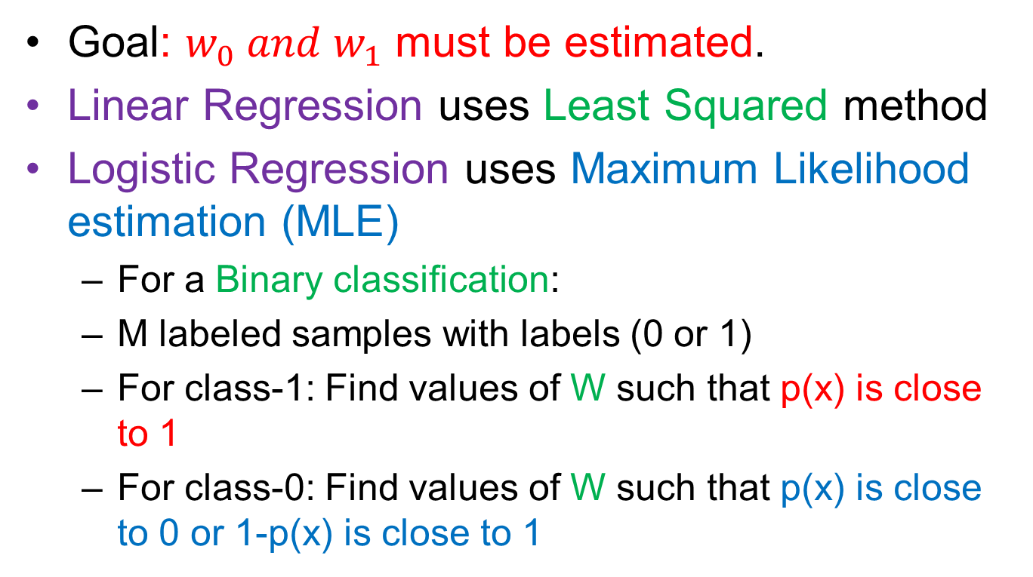
Logistic Regression
Goal: $w_{0} and w_{1}$ must be estimated.
Linear Regression uses Least Squared method
Logistic Regression uses Maximum Likelihood estimation (MLE)
For a Binary classification:
M labeled samples with labels (0 or 1)
For class-1: Find values of W such that p(x) is close to 1
For class-0: Find values of W such that p(x) is close to 0 or 1-p(x) is close to 1

Slide 9

Logistic Regression
Given samples $\left(x_{i},y_{i}\right)∈ℝ^{p}×\{0,1\},i=1,…m$
Assume: $p\left(x_{i}\right)=p\left(y_{i}=1∣x_{i}\right)$
$$p(x)=W^{T}x$$

Slide 10
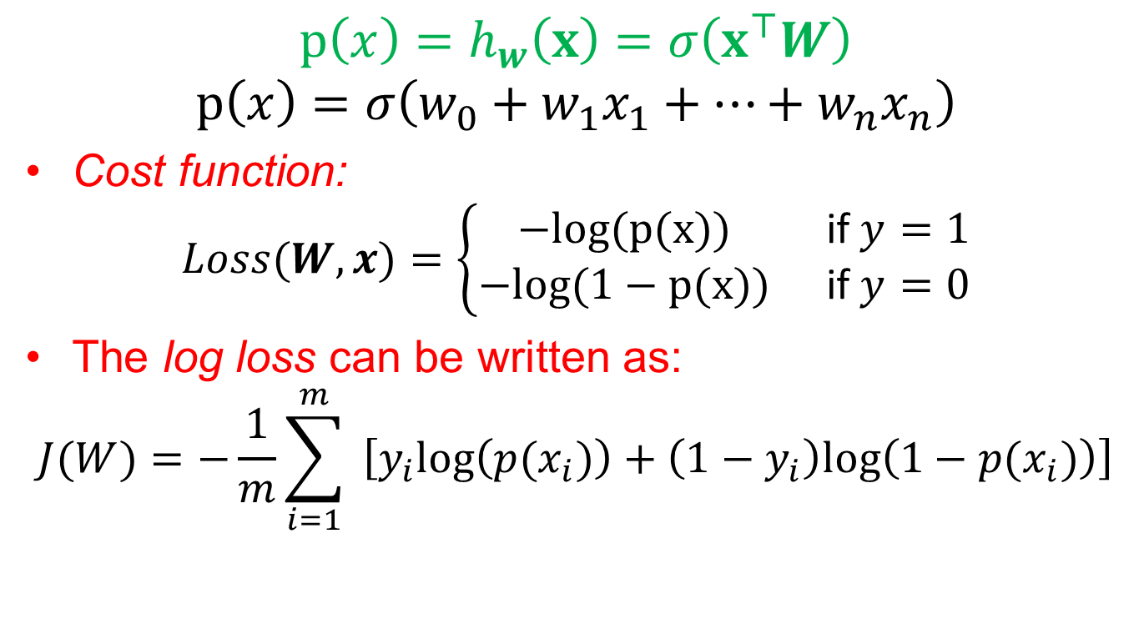
Logistic Regression
$$p\left(x\right)=h_{w}\left(x\right)=σ\left(x^{⊤}W\right)$$
$$p\left(x\right)=σ\left(w_{0}+w_{1}x_{1}+…+w_{n}x_{n}\right)$$
Cost function:
$$Loss(W,x)=\left\{\begin{matrix}−log⁡(p(x)) & \text{if} y=1 \\ −log⁡(1−p(x)) & \text{if} y=0\end{matrix}\right.$$
The log loss can be written as:
$$J(W)=−\frac{1}{m}\sum_{i=1}^{m}{ }\left[y_{i}log⁡\left(p(x_{i})\right)+\left(1−y_{i}\right)log⁡\left(1−p(x_{i})\right)\right]$$

Slide 11
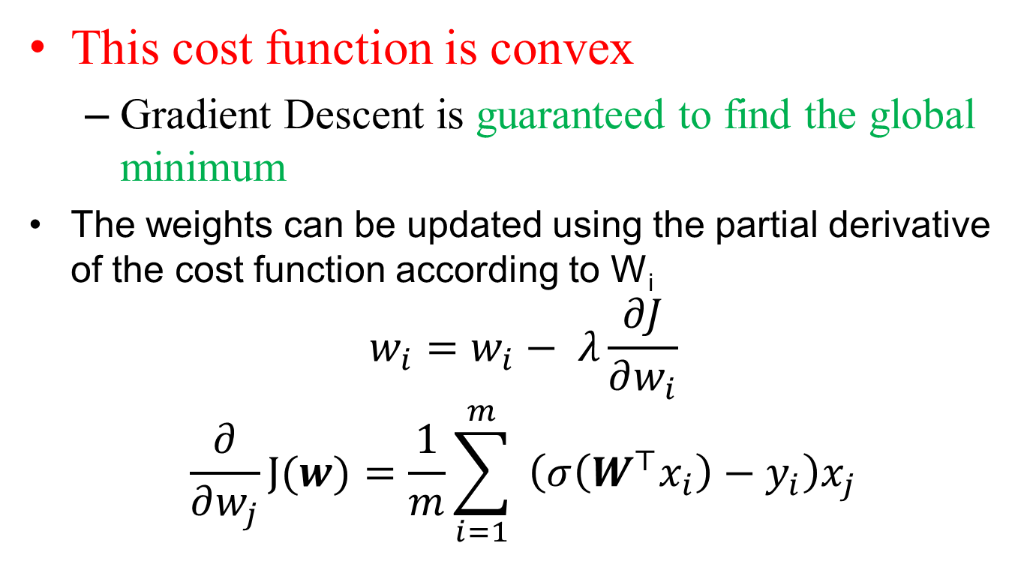
Logistic Regression
This cost function is convex
Gradient Descent is guaranteed to find the global minimum
The weights can be updated using the partial derivative of the cost function according to W_{i}
$$w_{i}=w_{i}− λ\frac{∂J}{∂w_{i}}$$
$$\frac{∂}{∂w_{j}}J(w)=\frac{1}{m}\sum_{i=1}^{m}{ }\left(σ\left(W^{⊤}x_{i}\right)−y_{i}\right)x_{j}$$

Slide 12
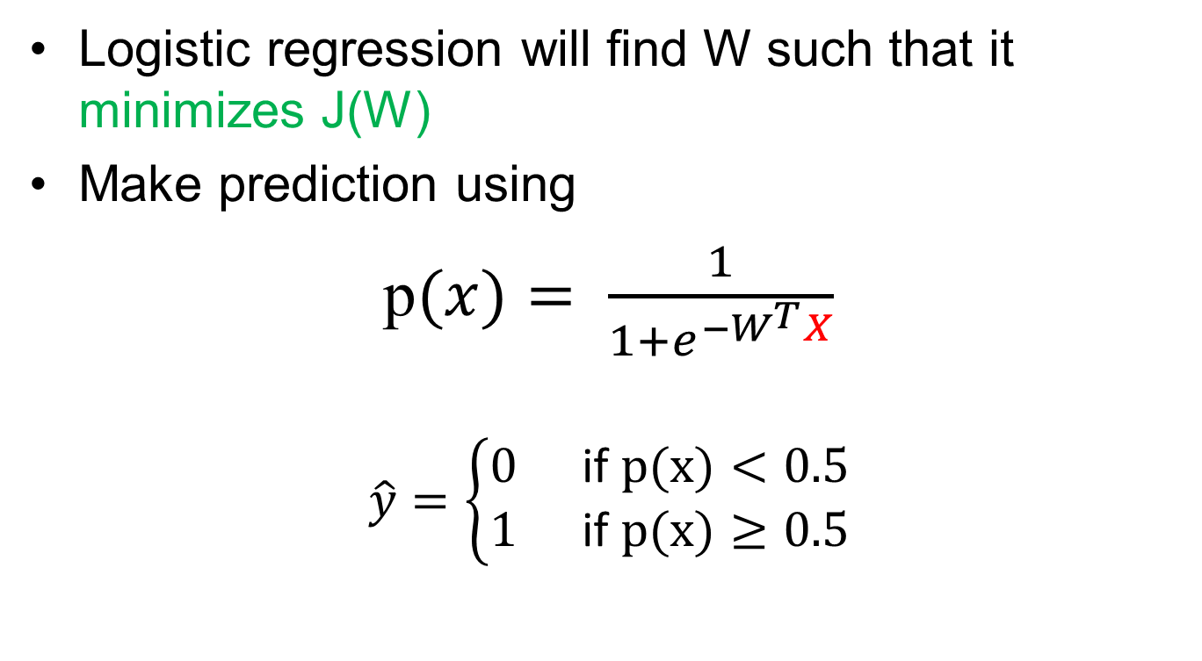
Logistic Regression
Logistic regression will find W such that it minimizes J(W)
Make prediction using
p$(x)= \frac{1}{1+e^{−W^{T}X}}$
$$\hat{y}=\left\{\begin{aligned}&0 && \text{if} p(x)<0.5 \\ &1 && \text{if} p(x)≥0.5\end{aligned}\right.$$

Slide 13
Multinomial regression
Can we extend the Logistic Regression model for multiclass classification(more than two) problems?
Yes ☺
Multinomial model regression
We can use One-vs-Rest (One-vs-all)
Divide the problem into many sub problems (binary)
Train separate model for one class vs rest classes
Repeat for all possible combinations for every class

Slide 14
Reference
Chapter 5, Deep Learning MIT Press 2016, Ian Goodfellow
Chapter 3 Pattern Recognition and Machine Learning, Christopher M. Bishop
Some graphics from the internet:
https://towardsdatascience.com/all-about-feature-scaling-bcc0ad75cb35

Slide 15
Thank You ☺

